Slide 1

“A GENERAL-PURPOSE COMPUTING CORE WITH COOPERATIVE MOTION DETECTION AND FEATURE EXTRACTION FOR ALWAYS-ON PWM IMAGE SENSORS”
NAME : Priethwin R (61782324103123)
Anandhakumar S (61782324103006)
GUIDE : Dr M Hema Kumar AP/ECE

Slide 2
Problem Statement:
Conventional vision systems consume significant power by continuously processing redundant image data. The proposed approach addresses this issue by combining low-power motion detection with motion-triggered feature extraction directly within the image sensor.
Introduction:
The rapid growth of machine vision and edge-AI applications has created a need for low-power, always-on vision systems. Conventional vision architectures consume significant power by continuously transferring and processing image data, including redundant information from static scenes. The proposed approach addresses this challenge by integrating motion detection and feature extraction directly within the image sensor. Motion detection is performed using frame-difference processing, and feature extraction is activated only when motion is detected. This processing-in-sensor approach reduces unnecessary computation and data transfer, enabling energy-efficient edge vision processing for always-on applications.

Slide 3
Objectives:
To develop a low-power processing-in-sensor architecture for always-on vision applications.
To detect motion using frame-difference processing directly within the image sensor.
To activate the feature-extraction process only when motion is detected, thereby reducing unnecessary computation.
To perform feature extraction using 3 × 3 convolution, ReLU activation, and 2 × 2 max pooling.
To reduce unnecessary image-data transfer between the image sensor and external processing units.
To achieve energy-efficient edge processing with low power consumption and reduced hardware overhead.

Slide 4
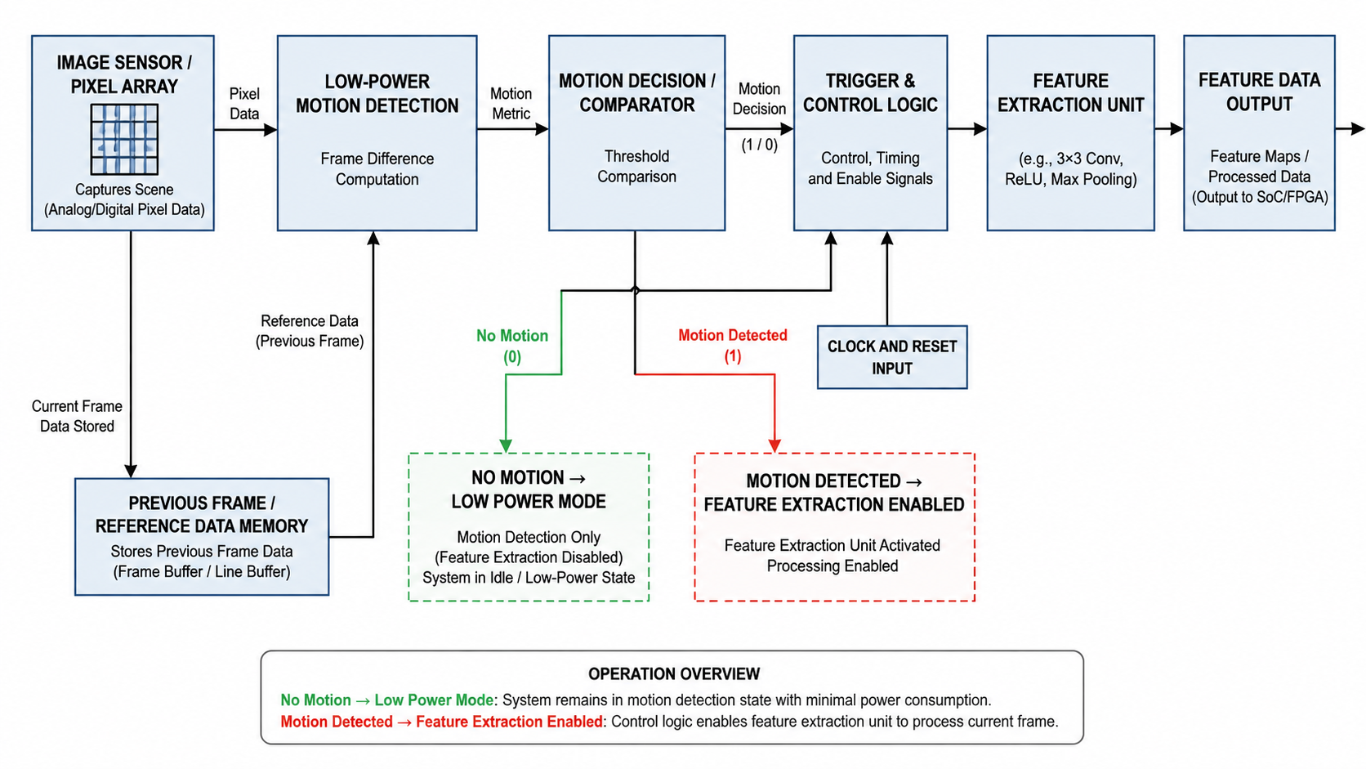

Slide 5
Working:
The CMOS image sensor first captures the image and generates PWM signals representing the image information. These PWM signals are provided to the in-column computing core for processing.
During motion detection, the system compares the current frame with the previous frame using frame-difference processing. The difference is compared with predefined threshold values to determine whether a change has occurred in the scene. If the detected change exceeds the preset threshold, the system identifies the presence of motion.
When no motion is detected, the system continues operating in the low-power motion-detection mode. When motion is detected, the feature-extraction operation is activated for the next frame. This motion-triggered operation prevents unnecessary feature extraction when the scene remains static.
During feature extraction, the computing core performs a 3 × 3 convolution using weighted current integration. The convolution results are then processed using the ReLU activation function, followed by 2 × 2 max pooling to generate the required feature map.

Slide 6
The extracted feature information can then be transferred to subsequent CNN layers for further processing and classification. In the experimental evaluation, the proposed computing core was used to process the first two layers of an ultra-lightweight CNN for MNIST digit classification.
Observation:
The system detects motion using frame-difference processing before performing feature extraction.
Feature extraction is activated only when motion is detected, reducing unnecessary processing of static images.
The system performs feature extraction using 3 × 3 convolution, ReLU activation, and 2 × 2 max pooling.
The proposed architecture achieves low-power and energy-efficient image processing, making it suitable for always-on edge-vision applications.

Slide 7
Outcomes:
The proposed computing core operates at 0.8 V and achieves a low-power, always-on image-processing capability.
The system consumes 5.23 µW during motion detection and 17.53 µW during feature extraction, with an energy efficiency of 1.5 TOPS/W.
The system successfully performs edge extraction and downsampling to generate a reduced feature map.
The proposed computing core achieves 95.09% MNIST classification accuracy, with only 0.86% accuracy degradation compared with the ideal software implementation.
Overall, the architecture reduces unnecessary computation and data transfer, making it suitable for low-power edge-intelligent vision applications.

Slide 8
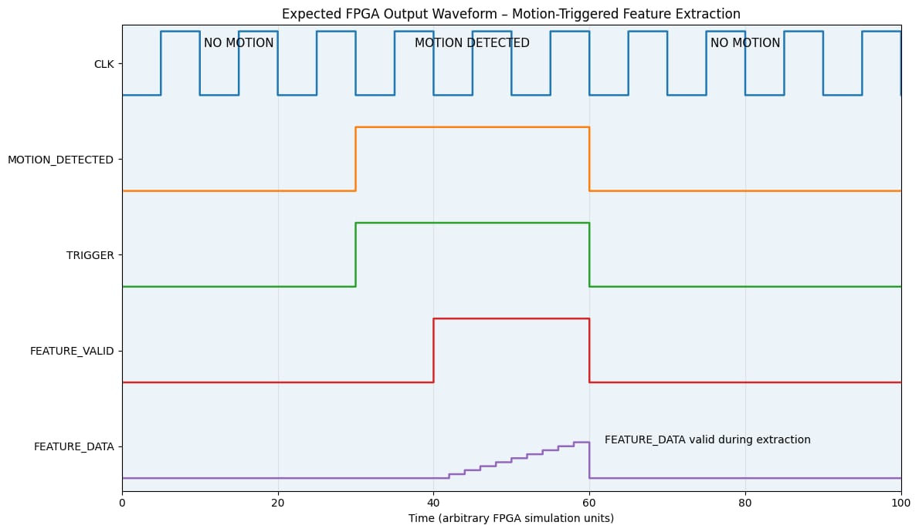

Slide 9
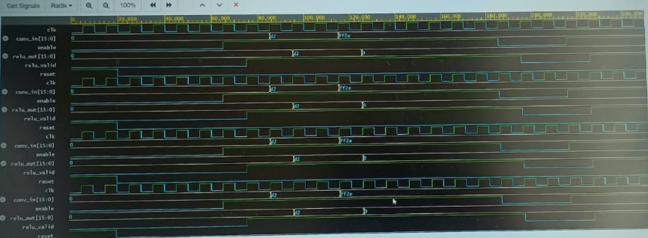

Slide 10


